Slide 1
San Francisco International Airport (SFO)
Parin Patel

Slide 2
Executive Summary
San Francisco International Airport (SFO) is located in California and is a major gateway to various San Francisco attractions and internationally, Europe and Asia. SFO is the largest airport in Northern California and the second busiest in California and West Coast, after Los Angeles. In 2017, it was listed as the seventh-busiest airport in the United States and the twenty-fourth busiest in the world (by passenger count). Serving as the fifth-largest airline hub for United Airlines and the secondary hub for Alaska airlines, SFO houses restaurants, cafes, stores, and many more.
Following analysis of SFO’s survey data where customers were asked to rate their experience at the airport with nineteen (19) different categories from cleanliness to travel style and spending behavior at the airport, we identified lapses in restaurant and store spending. By identifying where customer satisfaction were the lowest, we could identify and provide recommendations for improvement. Some of the analysis techniques included k-means clustering ,ordinal logit regression, and logistic regression.

Slide 3
Demographics

Slide 4
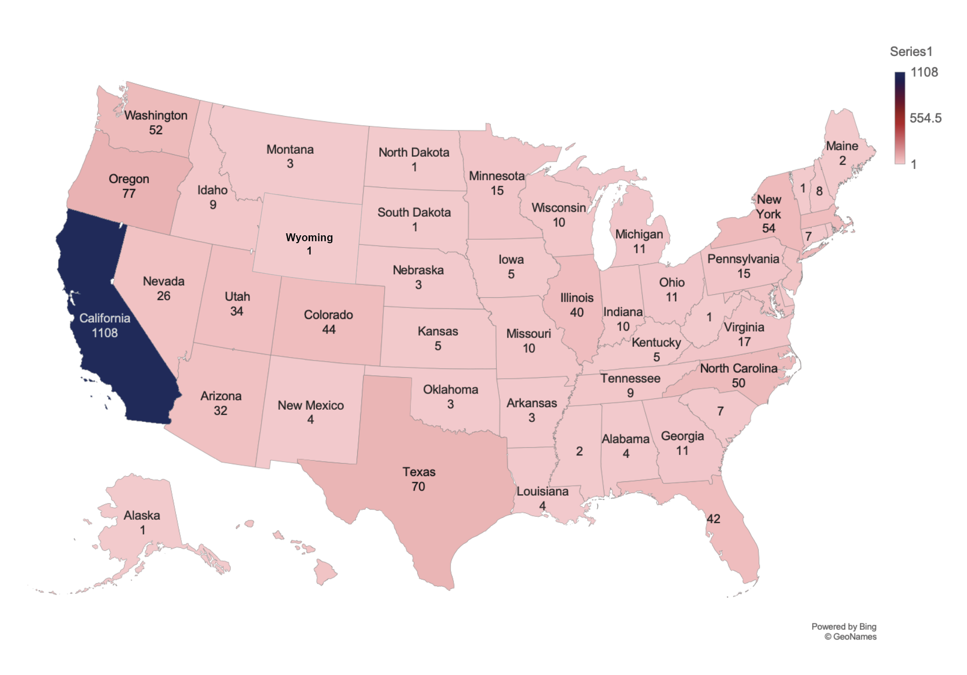
United States
CA | 1108 | 39.44%
OR | 77 | 2.74%
TX | 70 | 2.49%
NY | 54 | 1.92%
WA | 52 | 1.85%
NC | 50 | 1.78%
MA | 45 | 1.60%

Slide 5
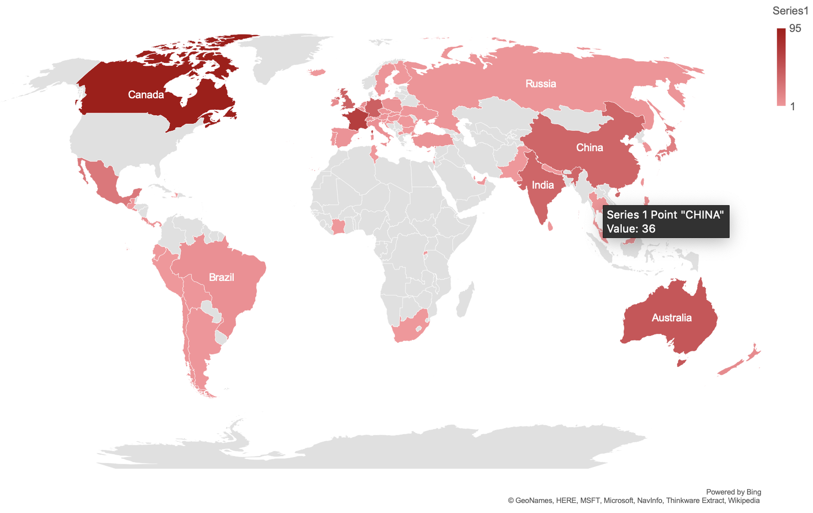
World
US | 2048 | 72.91%
CANADA | 95 | 3.38%
FRANCE | 66 | 2.35%
AUSTRALIA | 47 | 1.67%
GERMANY | 40 | 1.42%
UNITED KINGDOM | 39 | 1.39%
INDIA | 36 | 1.28%
CHINA | 36 | 1.28%
MEXICO | 23 | 0.82%
NEW ZEALAND | 10 | 0.36%

Slide 6
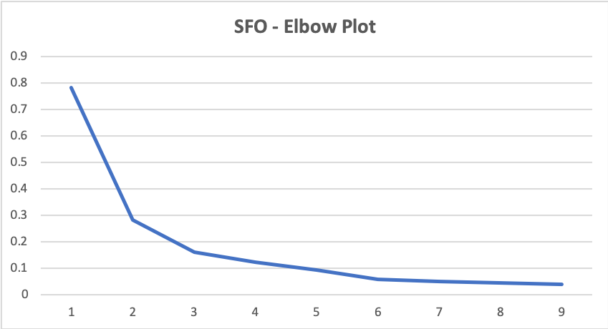
Elbow Plot
Evolution of Variance:
Variance\Classes | 2 | 3 | 4 | 5 | 6 | 7 | 8 | 9 | 10
Within-class | 5831.149 | 2921.962 | 1840.306 | 1440.581 | 1132.088 | 739.305 | 633.150 | 582.689 | 497.705
Between-classes | 7439.018 | 10348.205 | 11429.861 | 11829.586 | 12138.079 | 12530.862 | 12637.017 | 12687.478 | 12772.462
Total | 13270.167 | 13270.167 | 13270.167 | 13270.167 | 13270.167 | 13270.167 | 13270.167 | 13270.167 | 13270.167
Ratio | 0.783860093 | 0.282364163 | 0.161008627 | 0.12177778 | 0.093267438 | 0.058998732 | 0.05010278 | 0.04592628 | 0.03896706

Slide 7
K-means clustering
Survey Questions | Flyer 1 Profile | Flyer 2 Profile | Flyer 3 Profile
Flight time | PM (Flights departing after 5 pm) | MID (Flights departing 11 am to 5 pm) | PM (Flights departing after 5 pm)
Length from arrival to departure | 4 hours | 2 hours | 12 hours
Made store purchase | Yes | No | Yes
Made food purchase | Yes | Close split (yes & no) | Yes
Used free Wi-fi | Yes | Yes | Yes
Overall perception of SFO | Good view of SFO as a while. | Good view of SFO as a while. | Good view of SFO as a while.
Perception of restaurants (cleanliness) | (4) Slightly above average | (4) Slightly above average | (4) Slightly above average
Perception of restroom (cleanliness) | (4) Slightly above average | (4) Slightly above average | (4) Slightly above average
Navigating through the airport | (5) Easy | (5) Easy | (5) Easy
Age | B/w 25-34 & 55-64 | B/w 25-34 & 35-44 | 35-44
Gender | Closely male & female | Mostly female | Mostly male
Recommendation | Likely | Extremely likely | Extremely likely
Income | $50,000 - $100,000 | Over $150,000 | Over $150,000
The K-means clustering method was used to profile flyers in order to gain a deeper understanding of the types of people visiting and not visiting stores and restaurants at SFO.
Based on our model, we identified three (3) flyer profiles. This would not only serve as a means to understand SFO flyers, but would become essential for our recommendations to store and restaurant owners.
For example, the Flyer 3 profile are older people who are wealthy. They are more likely to spend more on stores and restaurants/bars due to their disposable income. Additionally, their longer stay at the airport makes them susceptible to impulse buys.

Slide 8
Ordinal Logit
Regression
Created two (2) different ordinal logit models to assess:
  Does time at the airport affect passenger referral rating?
  Does restaurant rating have an effect on passenger referral rating?
Note: Chose ordinal logit regression in this case because the survey asked respondents to give answers on an ordinal scale

Slide 9
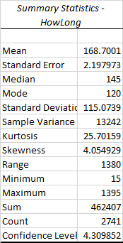
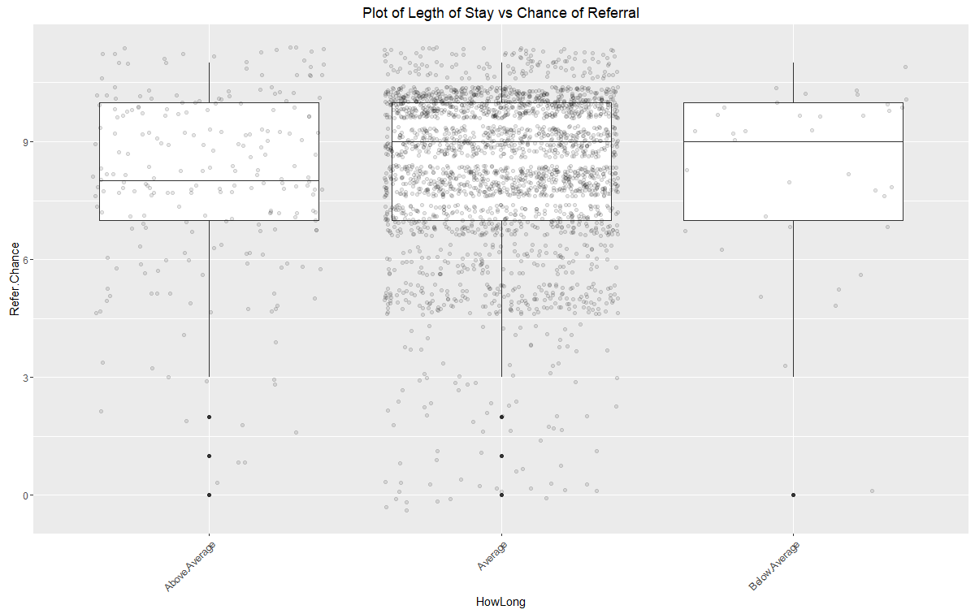
First model:
Time At Airport vs Referral
Using the Standard Deviation and Mean, we were able to create an ordinal code for passenger time at the airport.
  Noted in Minutes
  Removed all rows with no responses.
Outcome variable: Time at airport.
New Code
Below 52 Minutes | Below Average
53-283 Minutes | Average
Above 284 Minutes | Above Average

Slide 10
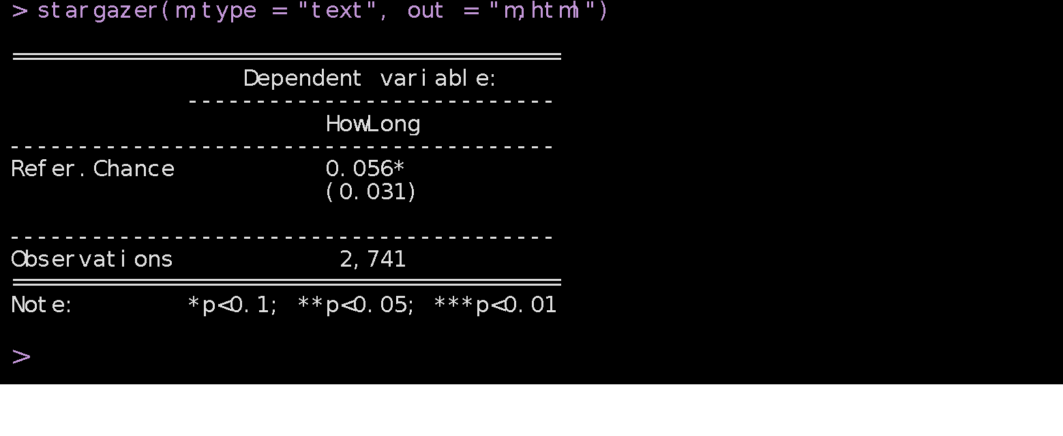
First model:
Time At Airport vs Referral
When Referral Chance increases one unit, it is 0.056 times more likely to be in a higher category. The odds of moving to a higher category in the outcome variable is -94% more likely when Referral Chance moves one unit.
Referral Chance is not statistically significant of time at the airport.
The longer a customer stays at the airport is not related to a better approval rating. We can take this to the restaurants and shops to help tune marketing strategies that are not focused on taking the time to attract customers.

Slide 11
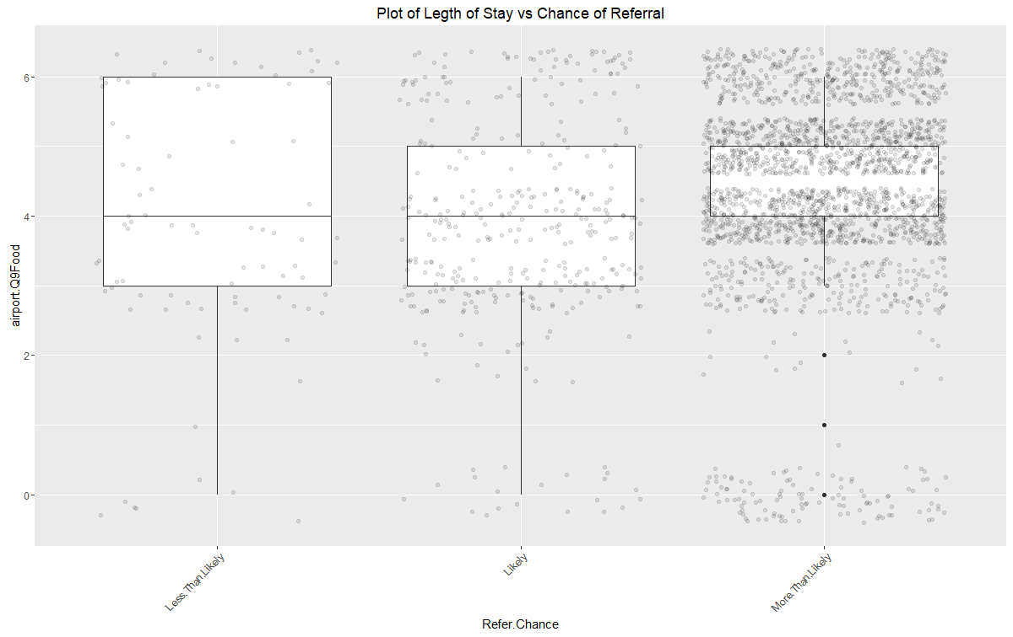
Secondly:
Passenger Referral vs Restaurant Rating
For the second model we re-coded passenger referral ratings to narrow our spread.
  Similar to the first, we grouped the referral into three categories.
New Code Referral
Below Rating of 4 | Less Than Likely to Refer
Rating 4-6 | Likely to Refer
Rating Over 6 | More Than Likely To Refer

Slide 12
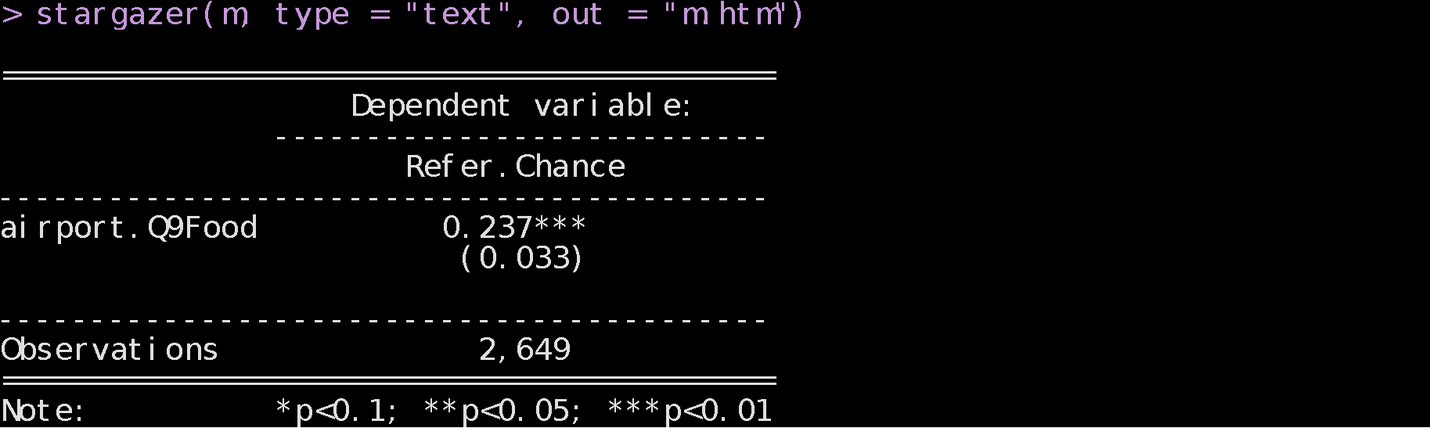
Secondly:
Passenger Referral vs Restaurant Rating
> (ctable <- cbind(ctable, "p value" = p)) Value Std. Error t value p value airport.Q9Food 0.2365578 0.0334059 7.081318 1.427900e-12 4|Less.Than.Likely -10.5045882 5.5492792 -1.892964 5.836260e-02 Less.Than.Likely|Likely -2.4470705 0.1701598 -14.381018 6.808602e-47 Likely|More.Than.Likely -0.6180365 0.1430515 -4.320377 1.557631e-05
>
When passengers chance of referral increases by one unit, it is 0.237 times more likely to be in a higher category. The odds of moving to a higher category in the outcome variable is 76.3% more likely when Referral Chance moves one unit.
Referral Chance is statistically significant to a passengers rating of the restaurant.
A passenger experience at SFO’s restaurants does affect the outcome of their referral.
(ci <- confint(m)) # default method gives profiled Cis
Waiting for profiling to be done...
2.5 % 97.5 %
0.1703717 0.3010730

Slide 13
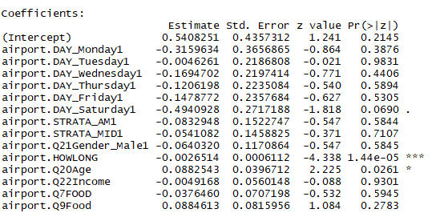
Logistic Regression
Logistic regression was done to try and isolate which variables have an effect on the likelihood of making a purchase at the restaurants.
Dummy variables to examine day of the week, time of flight and gender were introduced to measure if they had an effect.
Only the total time spent in the airport and the age showed statistical significance. As you spend more time in the airport, you’re less likely to make a purchase. As your age increases, you’re more likely to make a purchase.
People who are older most likely have more disposable income to spend in restaurants.
People spending more time in the airport most likely planned out their long stay and ate beforehand or packed their own food.

Slide 14
Recommendations
For future surveys, include information about grab-and-go food (premade food or vending machines)
Have smaller food options available for people in the airport a long time
Rerun survey to gather more info about people in SFO on layovers
Create a loyalty program where flyers can gain points by purchasing food or products from SFO stores & restaurants
Increase impulse purchases by redesigning SFO layouts and design leading up to stores & restaurants
Utilize Google Adwords for target advertising to show the great variety of restaurants

Slide 15
Thank You

